Slide 1
Planning Effective Learning Journeys
The HIAS English team 3 stage approach
Emma Scribbans
March 2018
Final

Slide 2
This document provides the pedagogy behind the example learning journey units based on rich texts within this section of Moodle+. The learning journeys build the skills and knowledge needed for a sustained write with growing independence.
We aim to create ‘writers’ not just ‘writing’
This powerpoint shows the planning process - an animation builds to reflect how planning can be approached effectively.
This is a tried and tested method in Hampshire schools that is known to be successful for all learners.

Slide 3
Planning for English should be a thoughtful, enjoyable and creative process, that doesn’t take too long!
Planned teaching needs to be driven by pupils’ needs and interests in order to engage and have impact on outcomes.
Communication and collaboration with colleagues are an important contributing factor to the success of planned learning journeys.

Slide 4
The presentation and layout of planning can be determined individually or by schools’ policies.
The level of detail within planning is dependent on the requirements of each individual teacher.
Above all, planning needs to be driven by teachers’ assessment in order to impact on effective teaching. Therefore all planning needs to be responsive, adaptive and flexible – a teacher’s ‘tool’ that supports the learning in the classroom.

Slide 5
GPaS
Reading
Writing
Spoken language
Parts are interlinked and merge towards final outcomes
Texts act as the drivers
The HIAS English
‘Melting Pot’

Slide 6
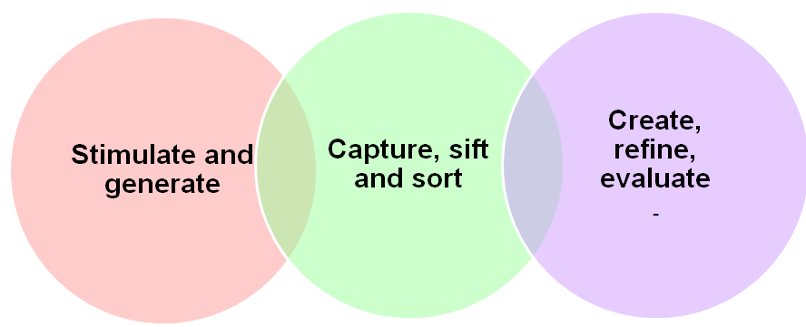
The HIAS 3 stage approach
Utilising a text driven curriculum
Building writers’ behaviours and skills

Slide 7
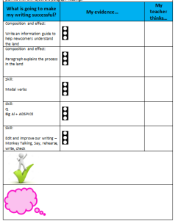
Rich text stimulus
Skills needed for final the outcome
Continue to teach skills and behaviours of a writer
Spoken language
Shared reading ‘reading as a writer’
Word level
Planning
Written outcome
Shared reading
‘reading as a reader’
Genre and form
Embedded GPaS
Proof reading and editing
Stimulate and generate
Capture, sift and sort
Create, refine, evaluate
Publish
Apprentice writes

Slide 8
Stimulate & Generate
Stimulate with hooks (generating excitement and interest)
Strategies for developing pupils’ vocabulary (‘warming up the words’)
Reading as a Reader (exploring events, characters and topics in the literary driver)
Developing spoken language to generate deeper understanding (drama & oral rehearsal)
Immerse children in the world of the text / theme – generate deeper understanding
Explore context – ensure every child ‘on the bus’ for the rest of the journey with required background knowledge

Slide 9
Capture, sift and sort
Observe the author’s craft - capture ideas and literary techniques
Identify author’s voice / style – experiment through apprentice writes
Sort ideas into careful sequences – use appropriate planning structures
Explore and grammatical techniques– capture those with greatest impact on the reader
Apprentice ‘give it a go’ short pieces
Explore high quality examples of genre and form – capture key features
‘Give it a go’ – scaffolded sentence level or apprentice paragraph

Slide 10
Create, Refine and Evaluate
Application of skills learnt to create sustained writing outcome
Refine draft through proof reading and editing
Evaluate - reflect against agreed success criteria
Publishing and presenting outcomes
Following a plan
Independent application of genre, form and author’s voice

Slide 11
HIAS English Team
The HIAS English team offer a wide range of high-quality services to support schools in improving outcomes for learners, including courses, bespoke consultancy and in-house training.
For further details referring to English, please contact either of the team leads:
Emma Tarrant : emma.tarrant@hants.gov.uk
Victoria Flynn: victoria.flynn@hants.gov.uk

